Slide 1







AI-Driven Landslide Susceptibility Prediction for Early Risk Mitigation
Team Members:
Selam Habtewold
Finhas Demissie
Bealu Girma
Date: 14-Oct-2024

Slide 2

Outline
Concept note and implementation plan
Background
Objectives
SDG Relation
Data
Data Collection
Exploratory Data Analysis et Feature Engineering
Model
Model Selection and Training
Model Evaluation and Hyperparameter Tuning
Model Refinement and Testing
Results
Evaluation Results
Deployment
Future Work

Slide 3
Concept note and Implementation Plan
Notes:
FTs like precision agriculture, remote sensing & AI-powered forming equipment can help increase agricultural productivity in LDCs. This can improve fiid security & contribute to the achievement of SDG 2 (Zero Hunger).

Slide 4
Background
Landslides are one of the most destructive natural hazards globally, causing loss of life, destruction of infrastructure, and environmental degradation.
Recent landslides, particularly in regions with high rainfall and unstable terrains, have emphasized the need for early detection and prevention.
This project aims to develop an AI-driven model to predict landslide susceptibility using key environmental factors (elevation, rainfall, slope, etc.).
The model can be applied in various regions to aid in proactive risk management and disaster preparedness.
Notes:
FTs like precision agriculture, remote sensing & AI-powered forming equipment can help increase agricultural productivity in LDCs. This can improve fiid security & contribute to the achievement of SDG 2 (Zero Hunger).

Slide 5
Objectives
Prediction Model: Create a machine learning-based model to identify regions susceptible to landslides based on environmental and geological factors.
User-Friendly Interface: Develop a web interface for local authorities and disaster management teams to input data and receive real-time risk predictions.
Scalability: Ensure the model is adaptable and can be used in different geographical locations worldwide.
Data-Driven Insights: Offer actionable suggestions to mitigate landslide risks for high-risk areas.
Notes:
FTs like precision agriculture, remote sensing & AI-powered forming equipment can help increase agricultural productivity in LDCs. This can improve fiid security & contribute to the achievement of SDG 2 (Zero Hunger).

Slide 6



SDG Relation
SDG 11 - Sustainable Cities and Communities: The project helps build resilient infrastructure, reduce the impact of natural disasters, and ensure urban safety by identifying risk zones.
SDG 13 - Climate Action: Contributes to climate resilience by predicting landslides exacerbated by extreme weather, such as heavy rainfall, due to climate change.
SDG 9 - Industry, Innovation, and Infrastructure: Promotes innovation in disaster management through the use of AI and data analytics to prevent loss of life and infrastructure damage.
Notes:
FTs like precision agriculture, remote sensing & AI-powered forming equipment can help increase agricultural productivity in LDCs. This can improve fiid security & contribute to the achievement of SDG 2 (Zero Hunger).

Slide 7
Data
Notes:
FTs like precision agriculture, remote sensing & AI-powered forming equipment can help increase agricultural productivity in LDCs. This can improve fiid security & contribute to the achievement of SDG 2 (Zero Hunger).

Slide 8
Data Collection
Dataset Source: The dataset used for this project was obtained from Kaggle
Features Collected: Aspect Curvature, Earthquake Activity, Elevation, Flow Accumulation, Lithology (Rock/Soil Type), NDVI (Vegetation Index), NDWI (Water Index), Plan Curvature, Precipitation, Profile Curvature and Slope (Terrain Steepness)
Preprocessing Steps during Data Collection: Data Cleaning:
Handling Missing Values:
Missing values were filled using appropriate methods such as: Mean/Median or Mode.
Scaling Features:
Min-Max Scaling is applied to continuous features to normalize the data
Notes:
FTs like precision agriculture, remote sensing & AI-powered forming equipment can help increase agricultural productivity in LDCs. This can improve fiid security & contribute to the achievement of SDG 2 (Zero Hunger).

Slide 9
Exploratory Data Analysis and Feature Engineering
EDA Process:
Purpose: Identify data patterns, detect anomalies, and understand relationships.
Techniques:
Histograms: Analyzed distributions of features like elevation, precipitation, and slope.
Box Plots: Detected outliers in features like precipitation and NDVI.
Correlation Heatmap: Identified strong correlations between features such as precipitation, slope, and elevation with landslide risks.
Notes:
FTs like precision agriculture, remote sensing & AI-powered forming equipment can help increase agricultural productivity in LDCs. This can improve fiid security & contribute to the achievement of SDG 2 (Zero Hunger).

Slide 10
Exploratory Data Analysis and Feature Engineering
Feature Engineering:
Feature Creation:
Slope × Precipitation: Captured interaction between steep terrains and rainfall.
Vegetation-Water Index (NDVI × NDWI): Assessed soil stability and moisture levels.
Feature Transformation:
Binning: Simplified continuous variables like elevation and precipitation into categories.
Interaction Features: Combined aspect and slope to analyze drainage and erosion impact
Notes:
FTs like precision agriculture, remote sensing & AI-powered forming equipment can help increase agricultural productivity in LDCs. This can improve fiid security & contribute to the achievement of SDG 2 (Zero Hunger).

Slide 11
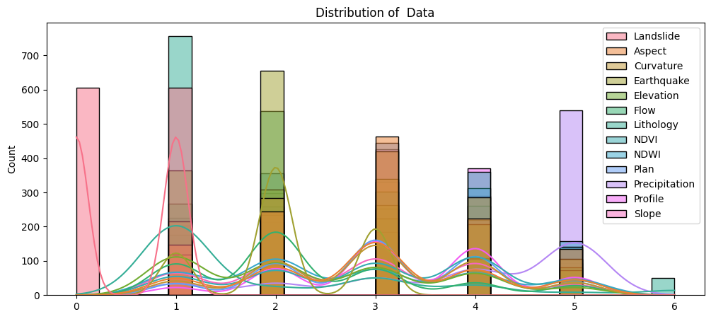
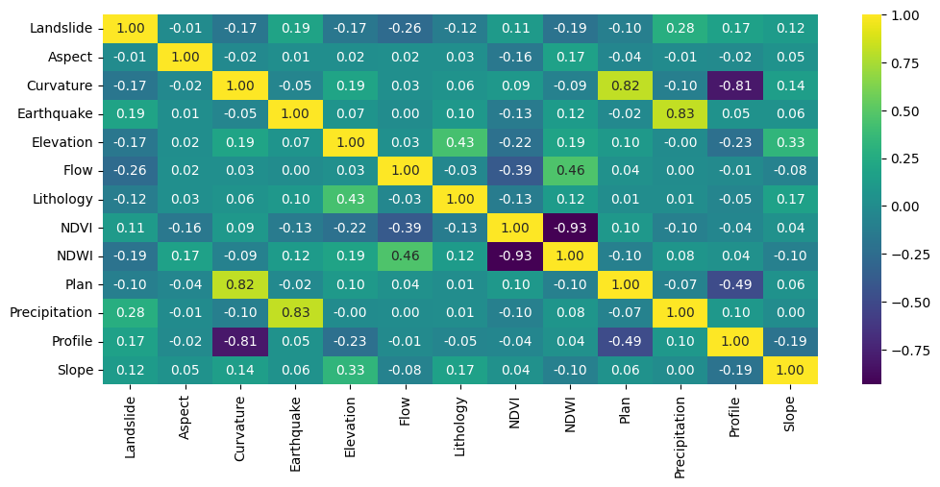
Correlation Matrix of Features in the Dataset
Notes:
FTs like precision agriculture, remote sensing & AI-powered forming equipment can help increase agricultural productivity in LDCs. This can improve fiid security & contribute to the achievement of SDG 2 (Zero Hunger).

Slide 12
Model
Notes:
FTs like precision agriculture, remote sensing & AI-powered forming equipment can help increase agricultural productivity in LDCs. This can improve fiid security & contribute to the achievement of SDG 2 (Zero Hunger).

Slide 13
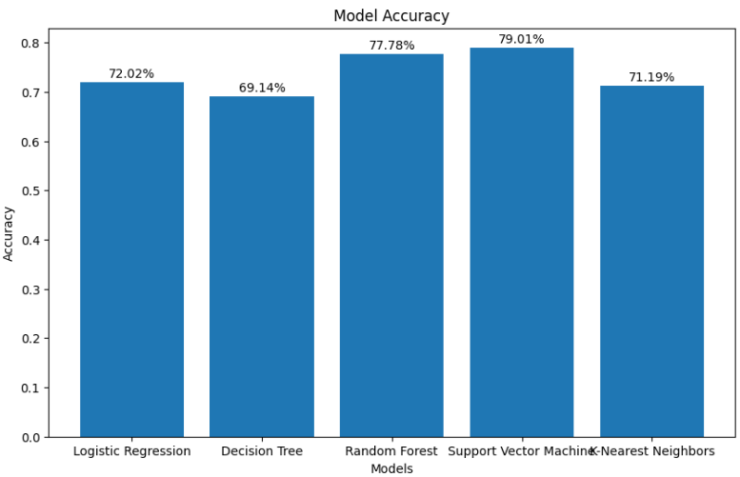
Model Selection and Training
In this project, we have trained five different machine learning models for landslide prediction and achieved varying accuracy levels across these models.
But none of the individual models provided a satisfactory level of accuracy therefore we adopted a hybrid model approach to improve overall performance.
Notes:
FTs like precision agriculture, remote sensing & AI-powered forming equipment can help increase agricultural productivity in LDCs. This can improve fiid security & contribute to the achievement of SDG 2 (Zero Hunger).

Slide 14
Model Selection and Training
The hybrid model combines the two highest-performing models:
Random Forest: 77.36% accuracy
Support Vector Machine (SVM): 79.01% accuracy
By integrating these models, we achieved a final accuracy of 81.06%.
Notes:
FTs like precision agriculture, remote sensing & AI-powered forming equipment can help increase agricultural productivity in LDCs. This can improve fiid security & contribute to the achievement of SDG 2 (Zero Hunger).

Slide 15
Model Evaluation and Hyperparameter Tuning
Hyperparameter tuning did not significantly impact the accuracy of our hybrid model, so we chose not to prioritize it.
For our hybrid model evaluation, the confusion matrix shows the following:
110 | 28
18 | 87
Notes:
FTs like precision agriculture, remote sensing & AI-powered forming equipment can help increase agricultural productivity in LDCs. This can improve fiid security & contribute to the achievement of SDG 2 (Zero Hunger).

Slide 16
Model Evaluation and Hyperparameter Tuning
Correct Predictions
True Positives (TP): 87 -
The model correctly predicted landslide occurrences.
True Negatives (TN): 110 -
The model correctly predicted no landslide occurrences.
Incorrect Predictions:
False Positives (FP): 28 -
The model incorrectly predicted landslide occurrences (Type I error).
False Negatives (FN): 18 -
The model failed to predict landslide occurrences (Type II error).
Overall, the hybrid approach has been effective in improving prediction accuracy and minimizing errors.
110 | 28
18 | 87
Notes:
FTs like precision agriculture, remote sensing & AI-powered forming equipment can help increase agricultural productivity in LDCs. This can improve fiid security & contribute to the achievement of SDG 2 (Zero Hunger).

Slide 17
Model Refinement and Testing
For testing our model, we used raw data from the same datasource and had the model predict the outcomes, which we then compared to the actual values.
In the majority of cases, the model provided accurate predictions, demonstrating its reliability. While there were a few instances where predictions were not accurate, this is expected given the model's accuracy of 81.06%.
Overall, the model's performance is promising, and the occasional errors are within an acceptable range for a model of this accuracy level.
Notes:
FTs like precision agriculture, remote sensing & AI-powered forming equipment can help increase agricultural productivity in LDCs. This can improve fiid security & contribute to the achievement of SDG 2 (Zero Hunger).

Slide 18
Results
Notes:
FTs like precision agriculture, remote sensing & AI-powered forming equipment can help increase agricultural productivity in LDCs. This can improve fiid security & contribute to the achievement of SDG 2 (Zero Hunger).

Slide 19
Evaluation Results
Model | Accuracy | F1-Score | Precision | Recall
Gradient Boosting | 0.790123 | 0.777293 | 0.717742 | 0.847619
Random Forest | 0.773663 | 0.759825 | 0.701613 | 0.828571
SVM | 0.790123 | 0.781116 | 0.710938 | 0.866667
Logistic Regression | 0.720165 | 0.711864 | 0.641221 | 0.800000
KNN | 0.711934 | 0.717742 | 0.622378 | 0.847619
Hybrid (RF + SVM) | 0.806584 | 0.787330 | 0.75000 | 0.828571
Notes:
FTs like precision agriculture, remote sensing & AI-powered forming equipment can help increase agricultural productivity in LDCs. This can improve fiid security & contribute to the achievement of SDG 2 (Zero Hunger).

Slide 20
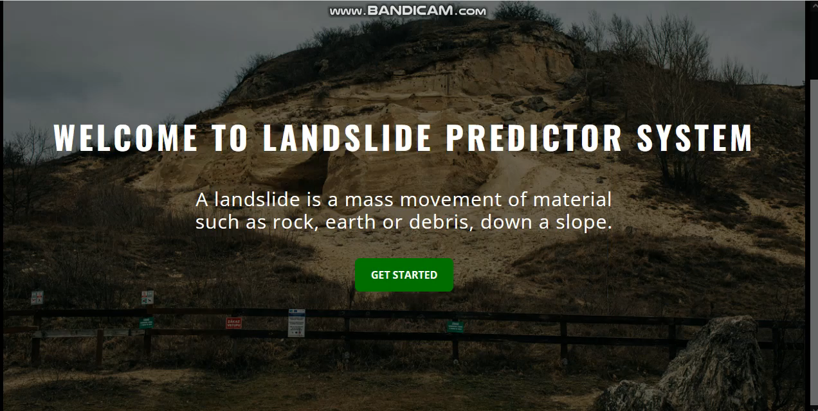
Deployment
Notes:
FTs like precision agriculture, remote sensing & AI-powered forming equipment can help increase agricultural productivity in LDCs. This can improve fiid security & contribute to the achievement of SDG 2 (Zero Hunger).

Slide 21
Future Work
Map Integration: We plan to integrate an interactive map where users can select specific regions and receive real-time landslide risk predictions with tailored suggestions.
Model Optimization: Further optimization of the model can be done by incorporating additional datasets, such as soil moisture and vegetation cover, to improve prediction accuracy.
Real-Time Monitoring: Incorporating IoT-based real-time monitoring of environmental conditions, such as precipitation and slope changes, can help enhance early warning systems.
Notes:
FTs like precision agriculture, remote sensing & AI-powered forming equipment can help increase agricultural productivity in LDCs. This can improve fiid security & contribute to the achievement of SDG 2 (Zero Hunger).

Slide 22
References
Kaggle Dataset :
Scikit-learn Documentation - [https://scikit-learn.org]
Pandas and Numpy Libraries - [https://pandas.pydata.org], [https://numpy.org]
Flask Documentation - [https://flask.palletsprojects.com]
Sustainable Development Goals (SDG) 11 & 13 - [https://sdgs.un.org/goals]
Notes:
FTs like precision agriculture, remote sensing & AI-powered forming equipment can help increase agricultural productivity in LDCs. This can improve fiid security & contribute to the achievement of SDG 2 (Zero Hunger).

Slide 23


Thank you!

